Slide 1

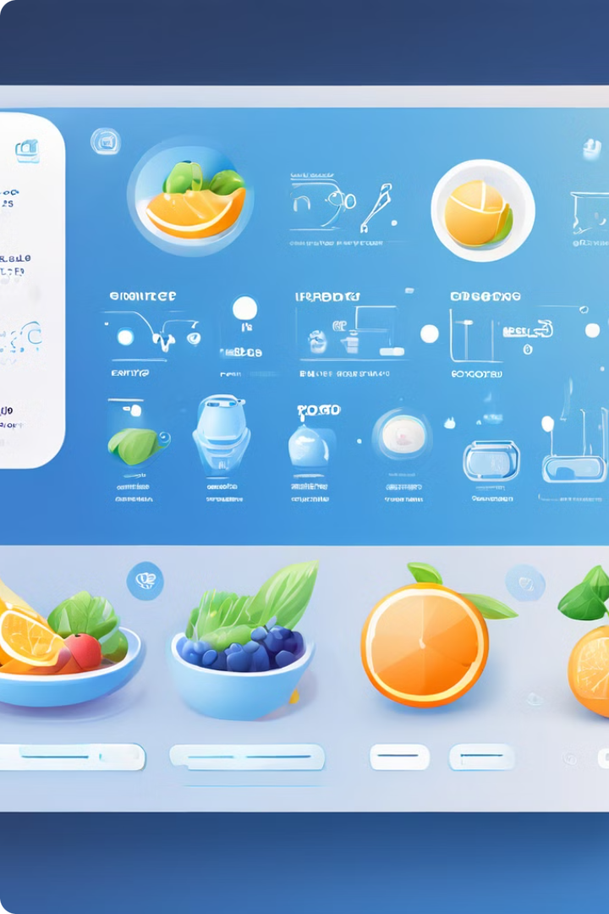

Food and Nutrition Chatbot
Adhyantini Bogawat
Chinmay Dharwad
Kishor Channal

Slide 2
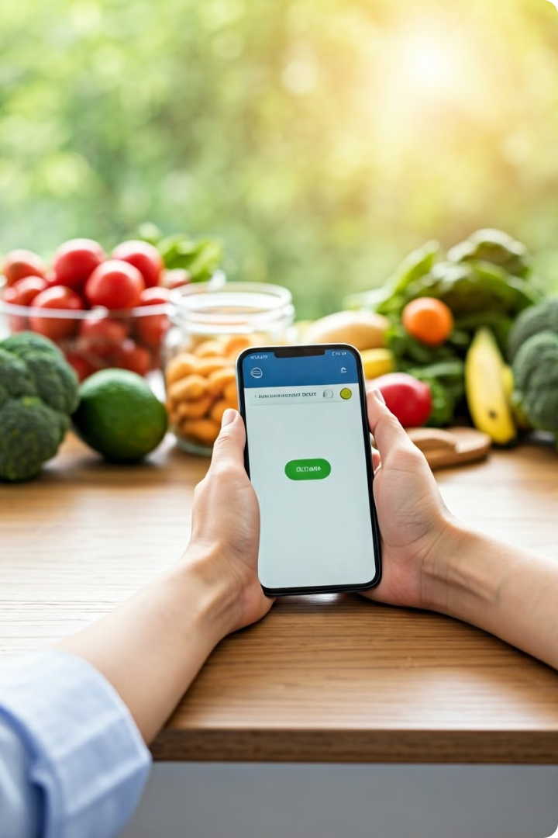
Introduction
1
Overview
The Food and Nutrition Chatbot offers personalized dietary advice and recipe suggestions.
2
Objectives
Provide nutritional information, cooking tips, and recipe suggestions based on available ingredients.
3
Importance
Integrates LLMs in health and wellness applications, making dietary advice more accessible.

Slide 3

Project Description
Description
Problem
Scope
A chatbot assisting users with food and nutrition-related queries.
Lack of accessible, personalized dietary advice.
Targets general public, health enthusiasts, and home cooks.

Slide 4
Project Architecture
1
User Interface
Streamlit provides the front-end for user interaction.
2
Query Processing
Gemini Pro LLM processes user queries.
3
Data Retrieval
PineCone Vector DB stores and retrieves relevant data.
4
Response Generation
Processed responses are displayed to the user.

Slide 5
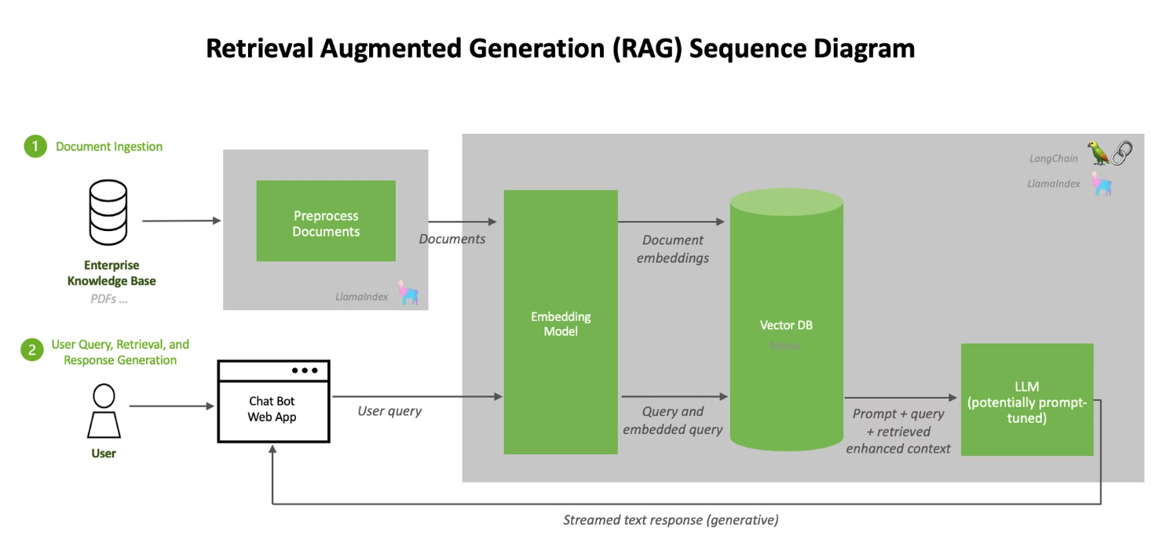

Slide 6
Data Collection and Preprocessing
Sources
Collection Steps
Preprocessing
Public datasets on nutrition, recipes, and dietary guidelines.
Extracting data from reliable sources. Cleaning and formatting data.
Tokenization, normalization, and embedding using text-embedding-004.

Slide 7
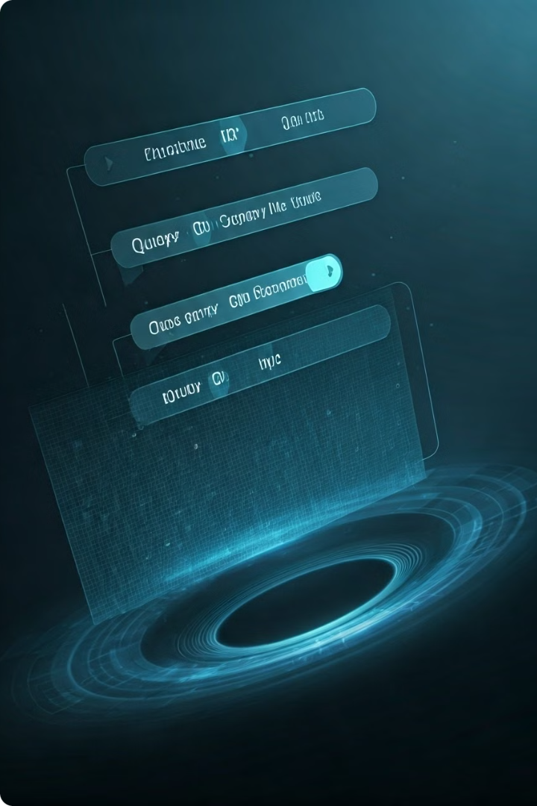



RAG Pipeline Implementation
Query Embedding
Convert user queries into vector representations.
Data Retrieval
Fetch relevant information from the vector database.
Response Generation
Generate accurate responses using retrieved data.

Slide 8
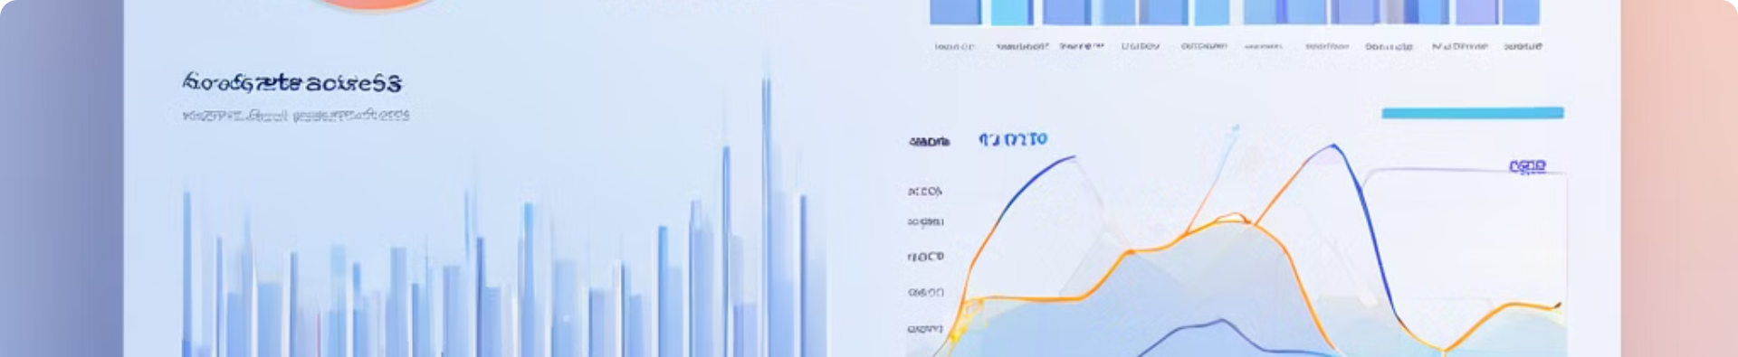
Performance Metrics
Metric
Method
Initial Results
Accuracy
Benchmark queries
High in nutritional info
Response Time
Timing tests
Quick responses
User Satisfaction
User feedback
Positive initial feedback

Slide 9
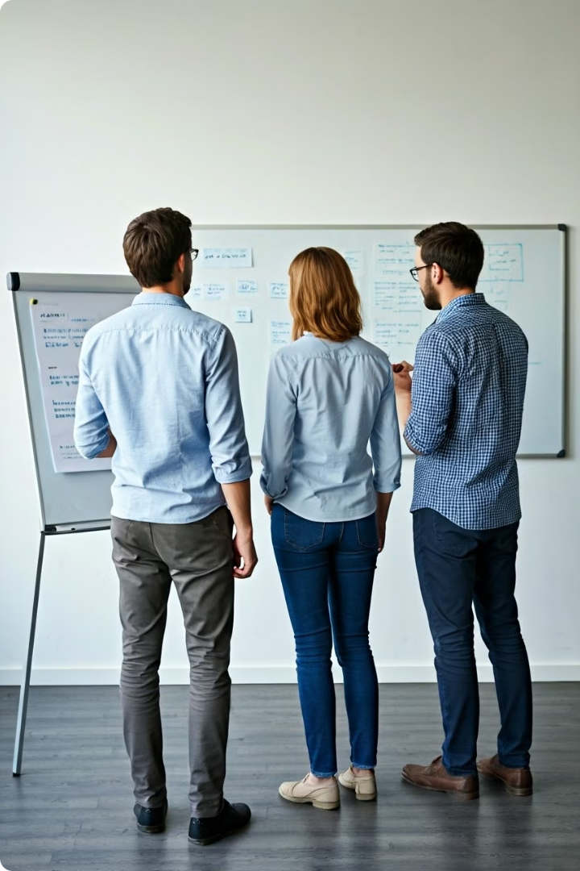



Methods to Improve Metrics
Enhance Data
Expand and refine training data sources.
Fine-tune Model
Optimize model parameters for better performance.
User Feedback
Incorporate user input for continuous improvement.

Slide 10
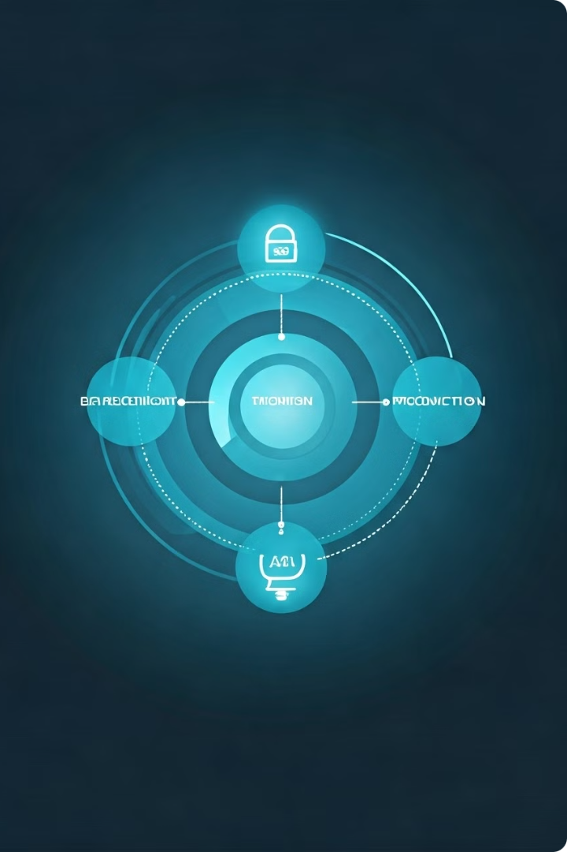
Deployment Plan
1
Finalize Codebase
Complete and review all code components.
2
Staging Environment
Test on Google Cloud Platform using Docker.
3
Beta Testing
Conduct user testing and collect feedback.
4
Full Deployment
Launch the chatbot for public use.

Slide 11

Future Work
Extensions
Long-term Vision
Continuous Development
Integrate with wearable devices and create personalized meal plans.
Develop a comprehensive digital health assistant.
Explore additional use cases and improve functionality.

Slide 12
Conclusion
Easier for users to access accurate and up-to-date nutritional information, promoting healthier eating habits
Helps users make healthier food choices tailored to their individual needs

Slide 13
Questions ?

